Slide 1

Hotel
Reservation
analysis
Debapriya Das
Aspiring Data Analysis

Slide 2
introduction
Hotel reservations are the lifeblood of the hospitality industry. Analysing reservation data can provide invaluable insights to optimize occupancy, revenue, and guest satisfaction. This presentation will explore key trends, strategies, and techniques for effective hotel reservations management.

Slide 3
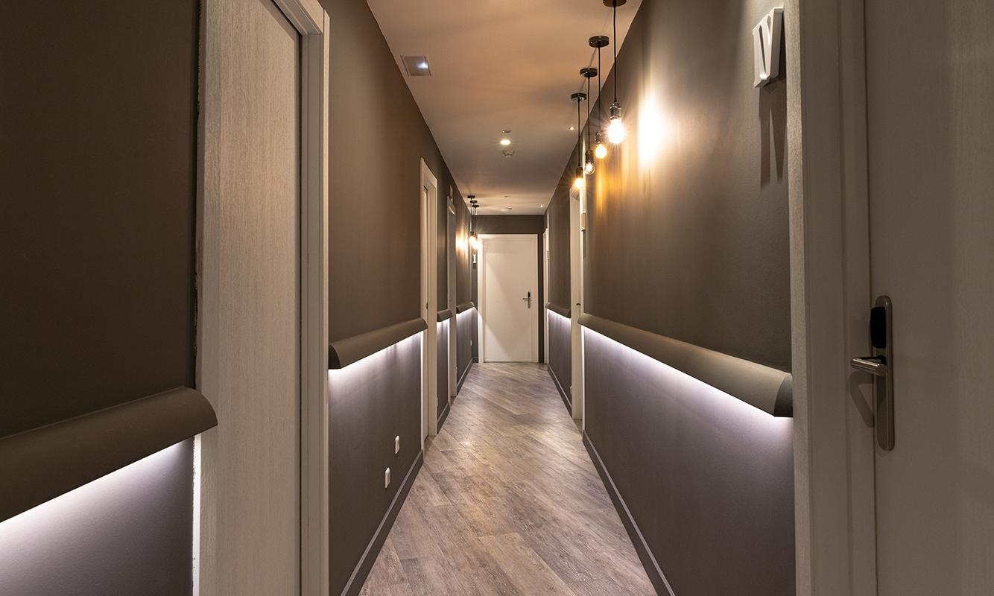
A picture always reinforces the concept

Slide 4
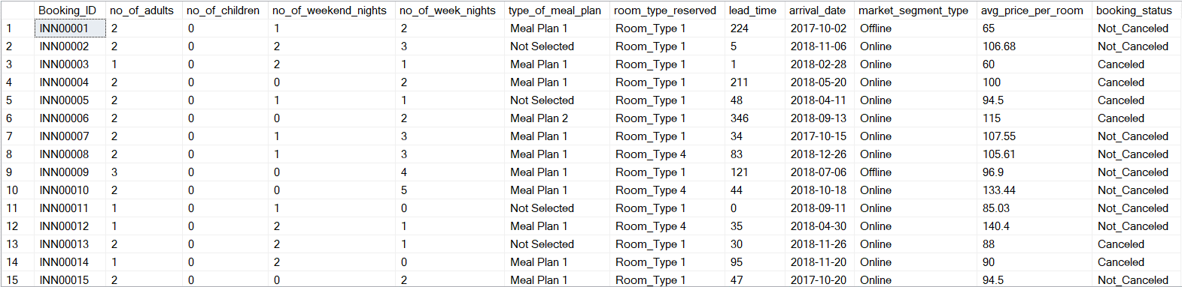
Database view
Code : select * from hotel_reservation
output:

Slide 5
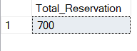
What is the total number of reservations in the dataset?
Code : SELECT COUNT(*) AS Total_Reservation
FROM hotel_reservation
output:

Slide 6
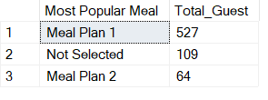
Which meal plan is the most popular Meal among guests?
Code : SELECT type_of_meal_plan AS 'Most Popular meal’,
COUNT(*) AS Total_Guest
FROM hotel_reservation
GROUP BY type_of_meal_plan
ORDER BY Total_Guest DESC
output:

Slide 7
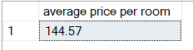
What is the average price per room for reservations involving children?
Code : SELECT ROUND(AVG(avg_price_per_room), 2) AS 'average price per room’
FROM hotel_reservation
WHERE (no_of_children > 0)
output:

Slide 8
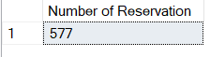
How many reservations were made for the year 2018?
Code : SELECT COUNT(*) AS 'Number of Reservation’
FROM hotel_reservation
WHERE (YEAR(arrival_date) = 2018)
GROUP BY YEAR(arrival_date)
output:

Slide 9
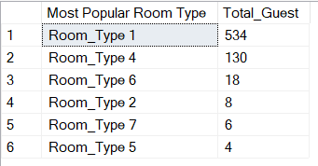
What is the most commonly booked room type?
Code : SELECT room_type_reserved AS
'Most Popular Room Type’,
COUNT(*) AS Total_Guest
FROM hotel_reservation
GROUP BY room_type_reserved
ORDER BY Total_Guest DESC
output:

Slide 10
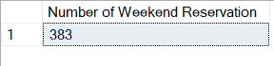
How many reservations fall on a weekend (no_of_weekend_nights > 0)?
Code : SELECT COUNT(*) AS
'Number of Weekend Reservation’
FROM hotel_reservation
WHERE (no_of_weekend_nights > 0)
output:

Slide 11
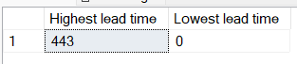
What is the highest and lowest lead time for reservations?
Code : SELECT MAX(lead_time) AS 'Highest lead time’,
MIN(lead_time) AS 'Lowest lead time’
FROM hotel_reservation;
output:

Slide 12
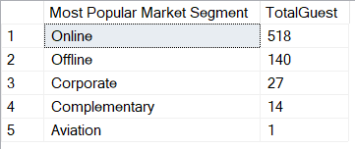
What is the most common market segment type for reservations?
Code : SELECT market_segment_type AS
'Most Popular Market Segment’,
COUNT(*) AS TotalGuest
FROM hotel_reservation
GROUP BY market_segment_type
ORDER BY TotalGuest DESC
output:

Slide 13
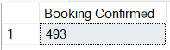
How many reservations have a booking status of "Confirmed"?
Code : SELECT COUNT(*) AS 'Booking Confirmed’
FROM hotel_reservation
WHERE (booking_status = 'Not_Canceled');
output:

Slide 14
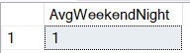
What is the average number of weekend nights for reservations involving children?
Code : SELECT AVG(no_of_weekend_nights) AS AvgWeekendNight
FROM hotel_reservation
WHERE (no_of_children > 0)
output:

Slide 15
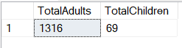
What is the total number of adults and children across all reservations?
Code : SELECT SUM(no_of_adults) AS TotalAdults,
SUM(no_of_children) AS TotalChildren
FROM hotel_reservation
output:

Slide 16
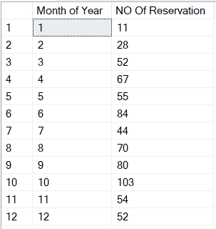
How many reservations were made in each month of the year?
Code : SELECT MONTH(arrival_date) AS 'Month of Year’,
COUNT(*) AS 'NO Of Reservation’
FROM hotel_reservation
GROUP BY MONTH(arrival_date)
output:

Slide 17
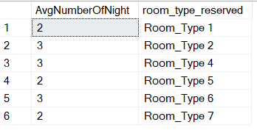
What is the average number of nights (both weekend and weekday) spent by guests for each room type?
Code : SELECT AVG(no_of_weekend_nights + no_of_week_nights)
AS AvgNumberOfNight, room_type_reserved
FROM hotel_reservation
GROUP BY room_type_reserved
output:

Slide 18
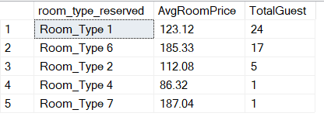
For reservations involving children, what is the most common room type, and what is the average
price for that room type?
Code : SELECT room_type_reserved,
ROUND(AVG(avg_price_per_room), 2) AS AvgRoomPrice,
COUNT(*) AS TotalGuest
FROM hotel_reservation
WHERE (no_of_children > 0)
GROUP BY room_type_reserved
ORDER BY TotalGuest DESC
output:

Slide 19
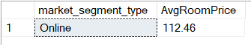
Find the market segment type that generates the highest average price per room.
Code : SELECT TOP (1) market_segment_type,
ROUND(AVG(avg_price_per_room), 2) AS AvgRoomPrice
FROM hotel_reservation
GROUP BY market_segment_type
ORDER BY AvgRoomPrice DESC
output:

Slide 20
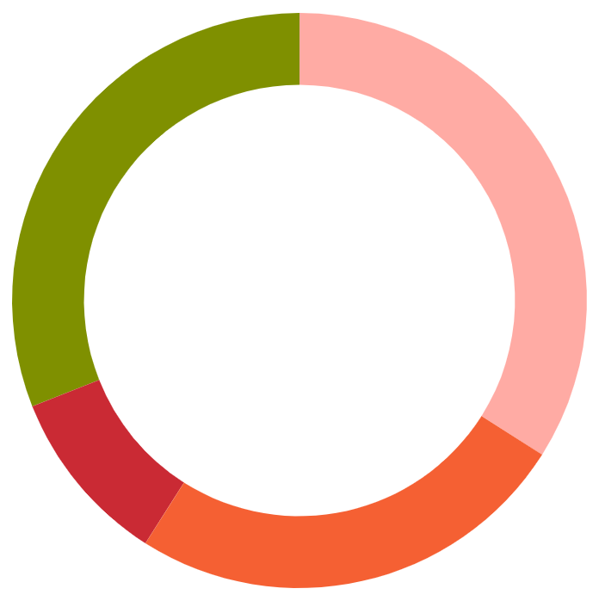
Market share
Online - 74%
Offline - 20%
Most Of the Booking are done through Online
Some group of peple rely on offline
Corporate - 03%
Complementary - 02%
Hotels are also get the booking from Corporate
Very Less percentage of booking are came from
Complementary
Notes:
202020

Slide 21
Popular Meal category
Meal plan 1
Total 527 choose this meal category
Not selected
109 choose this meal category
Meal plan 2
700
Rest 64 choose this meal category
Among total reservations

Slide 22
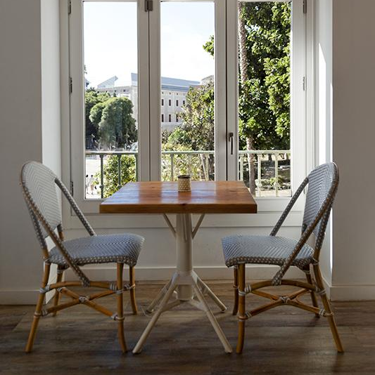
This is a short Analysis
Where I get the total dataset from MENTORNESS, after analysing all the data using MS SQL Server I get above information’s

Slide 23



Thanks!
Does anyone have any questions?
ddebapriya.27@gmail.com
+91 6290653970
You can also visit my LinkedIn & GitHub Profile to see my previous
Projects
LinkedIn
GitHub

